Slide 1

SWAN; an enabler for quality care at the End of Life

Slide 2
To promote dignity, respect & compassion at the end of life
Why SWAN? Meaning ‘a happy death’ in roman days
Sign – is the patient believed to be entering the dying phase of life; start the individual plan of care & support for the dying person
Words – sensitively communicate with the patient & those important to the patient
Actions – step outside the box & facilitate what is important to the patient
Needs – are the needs of the patient being met, documented & reviewed regularly

Slide 3
Importance of..
Making EOLC everyone's business
Create a culture of openness at EOL – Educating & reassuring the public on the concept of SWAN
Facilitating choice
Joining up EOLC / Bereavement care / Tissue donation
How can I make a difference to this patient & family in the moment. #onechance

Slide 4
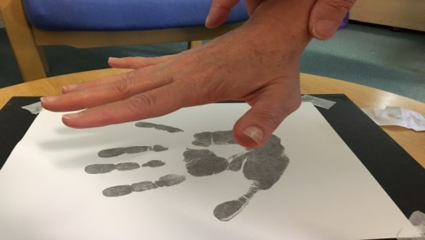
SWAN Resource Box
The SWAN symbol by the bedside to alert all staff around that the patient & family are in an end of life care situation.
Comfort packs; a set of toiletries that the family can use if they are staying with their loved ones
Memory boxes; to facilitate a place to collect memories of the patient, particularly for families with children
Handprint resources; to facilitate families being offered the choice of having a handprint taken of the patient
Small memory bags; to facilitate the offer of a hair lock being taken or jewellery being placed in them
Bereavement SWAN bags; to facilitate the property of the patient being returned to the family in a dignified, respectful way rather than the plastic bags currently used. Staff would be able to recognise this bag by its symbol & respond compassionately.
Tissue donation information; to facilitate early conversations

Slide 5
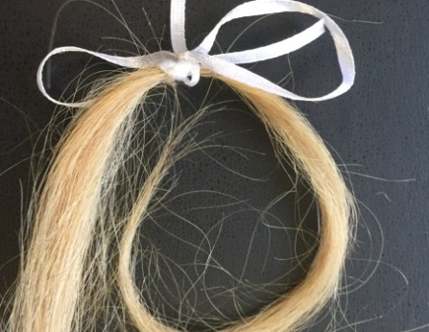
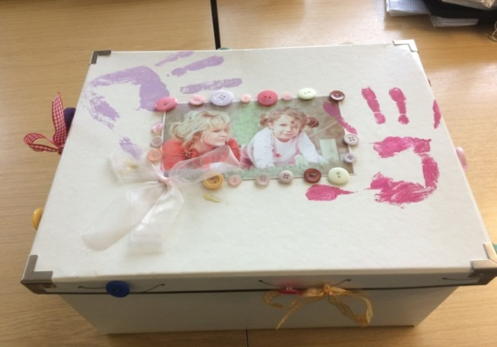
Good for the patient
Heightened dignity & respect
Situation acknowledged & care individualised
Well informed & prepared
What matters to the patient prioritised; choices
Open access to those important to them
Quality, compassionate care

Slide 6


Good for those important to the patient
Open visiting
Well informed & prepared
Drinks & food provided
Practical support
Free car parking
Moments making memories

Slide 7

Good for us
Raises awareness
EOLC is everyone's business
One chance to get it right
Gives our families & patients control
Compassion & satisfaction
Their experience matters to us
Consistent information
Quality care
Permission to act
Care of the family carries on after death

Slide 8
SWAN; Key messages
EOLC is everyone's business
We have once chance to get it right
Moments make memories
You leaving our care supported matters to us
Permission to act & break the rules that don’t exist
What can you do to improve EOLC at NUH?

